Slide 1

Bank Loan Analysis
Domain: Finance ANALYTICS

Slide 2


KPI’S
Year wise loan amount Stats
Grade and sub grade wise revol_bal
Total Payment for Verified Status Vs Total Payment for Non Verified Status
State wise and month wise loan status
Home ownership Vs last payment date stats

Slide 3
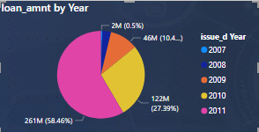
1. Year wise loan amount stats
Observation:
The data shows a consistent increase in loan amounts from 2007 to 2011, indicating a growing lending activity for the bank. This trend suggests successful efforts in attracting borrowers and expanding the loan portfolio over time.
Suggestions:
Diversify Loan Portfolio: While growth in lending activity is positive, it's essential to ensure diversification across different loan types and customer segments. This can help mitigate risks associated with overexposure to specific industries or borrower profiles.
Enhance Risk Management: With increased lending activity, it's crucial to strengthen risk management practices. This includes robust credit assessment procedures, monitoring of loan performance, and proactive identification of potential risks. Implementing advanced analytics and risk modelling techniques can aid in better risk assessment.

Slide 4
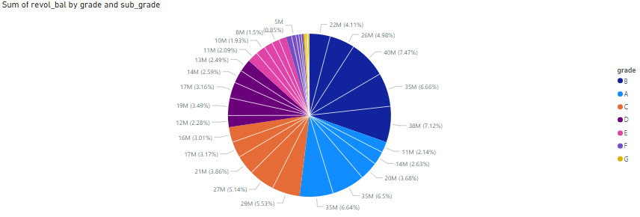
2. Grade and sub-grade wise revolving balance.
Observation:
Grade-wise Distribution:
The data shows a clear distribution of revolving balances across different loan grades. Higher grades (A, B) tend to have higher sums of revolving balances compared to lower grades (F, G)
Suggestions:
Provide educational resources and support to borrowers, especially those in higher-risk grade/subgrade categories, to help them better manage their revolving balances and improve their financial literacy.
Regularly review and adjust credit limits for borrowers in higher-risk grade/subgrade categories to align with their financial capacity and minimize the risk of overleveraging.

Slide 5
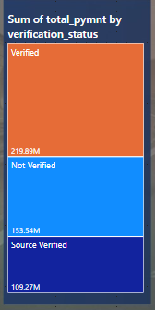
3. Total Payment verified Vs Non-verified income status
Observation:
Verified status accounts for the highest sum of total payments, followed by Not Verified and Source Verified statuses.
The sum of total payments for Verified status is substantially higher than the sums for the other two verification statuses.
Suggestions:
Enhance Verification Processes:
Strengthen and streamline the verification processes to ensure accuracy and reliability in assessing borrower information.
Implement additional verification checks or procedures to validate borrower income, employment, and other relevant details.

Slide 6
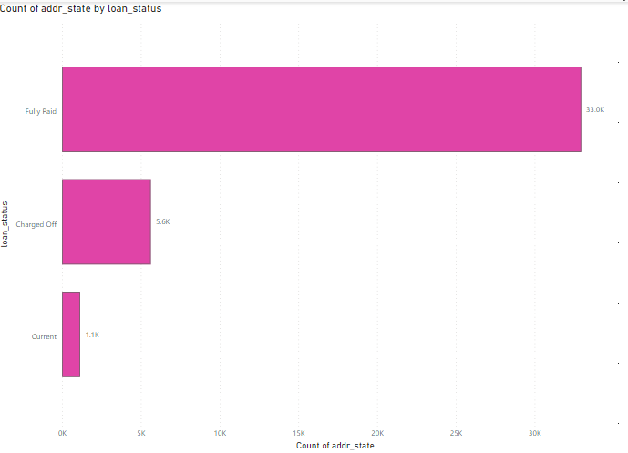
4. State-wise and loan-wise loan Status
Insights:
Fully Paid has the highest count of addr_state, significantly higher than Charged Off and Current.
Charged Off has a moderate count compared to Fully Paid but is still notably higher than Current.
Current has the lowest count of addr_state.
Fully Paid accounts for the majority of addr_state counts, representing 82.96% of the total.
Suggestions :
Risk Assessment: Given that Charged Off represents a significant portion of addr_state counts, it's crucial to assess the factors contributing to loans being charged off. This could involve reviewing creditworthiness criteria, loan terms, and borrower profiles to mitigate future losses.
Customer Retention: Focus on maintaining a high percentage of Fully Paid loans by implementing strategies to support borrowers in fulfilling their loan obligations. This could include personalized financial guidance, flexible repayment options, and proactive communication to address any potential issues.

Slide 7
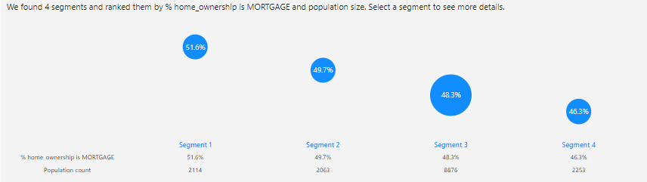
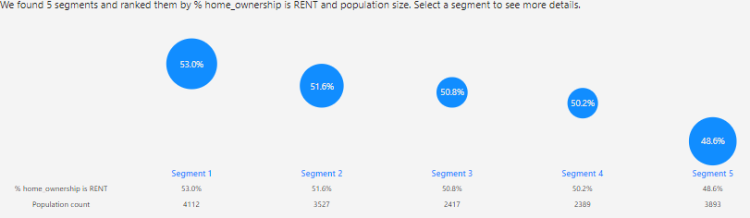
5. Job Role Vs Work life balance

Slide 8
Job Role Vs Work life balance
Suggestions :
1.Segmentation Analysis:
Segment borrowers within each home ownership category based on additional factors such as credit score, loan amount, interest rate, etc.
Analyze payment behavior and default rates among different segments to identify risk factors and potential areas for improvement.
2.Predictive Modeling:
Develop predictive models to forecast future payment trends and identify early warning signs of delinquency or default.
Utilize machine learning algorithms to identify patterns in payment behavior and predict future payment outcomes.

Slide 9
Conclusion
KPI-1: Loan distribution across various grades highlights the risk profile of borrowers.
KPI-2: A significant portion of loans being fully paid indicates healthy repayment behavior.
KPI-3: Insights into loan distribution across states and months identify regions and time periods with higher loan activity.
KPI-4: Examination of loan statuses by state and month reveals variations in performance across geographic and temporal dimensions.
KPI-5: The relationship between home ownership and last payment date uncovers trends and payment behavior among different borrower categories.

